Slide 1
Choosing interaction devices: hardware components Lecture 5

Slide 2
Interaction Devices
Every UI consists of a mixture of design components:
Hardware components. The hardware components are usually referred to as the input/output devices, or interaction devices. These may include a keyboard, mouse, joystick, screen, and so on.
Software components. The software components are the aspects of the UI that are generated by the underlying computer program, such as the image on the screen and the sounds from the speakers. Thus, these include the layout of the screen, use of color, images, text, animation, sound, and video clips.

Slide 3
Why Study Interaction Devices?
You may work for a company that uses a limited range of interaction devices and is unwilling to change them. For example, the purchasing department of the company may always buy a particular make of PC with a screen, keyboard, and mouse. Why?
There are probably several good reasons:
The company may be able to buy the systems more cheaply in bulk.
Maintaining the PCs will be easier, as technical support will only need to know about one type of system.
The organization will contain a considerable amount of expertise on the system. For example, it could cost a great deal of money to retrain all the users to operate a different keyboard.
It is easier to continue with a solution that you are comfortable with than to take the risk of changing.
If this describes your situation, then you may be wondering: what is the point of studying interaction devices when you are unlikely to be able to change them?

Slide 4
Input Devices
Two categories of input device:
Keyboards, keypads, and buttons. There are a variety of keyboards and keypads. Individual buttons are also used extensively, particularly in embedded computer systems.
2. Pointing devices. We divide this category into indirect pointing devices, such as the mouse and joystick, and direct pointing devices, such as the touchscreen and stylus-based systems.
For both categories we consider what the particular devices can best be used for and how to choose between them

Slide 5
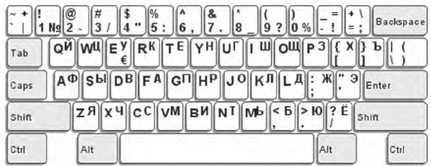
QWERTY Keyboard Layout
Keyboards, keypads, and buttons are all discrete input devices.
Discrete input devices can be used to enter individual items of information, such as letters and numbers or commands.
Keyboards for other languages have different layouts, sometimes simply adding characters with accents (e.g., é in French, ö in Dutch) or more extensive changes to allow easier entry of other scripts, as in the Russian keyboard shown in following Figure (QWERTY layout)

Slide 6
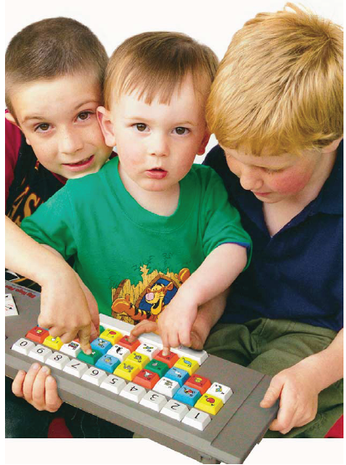
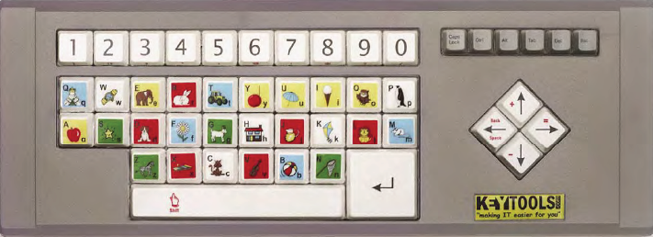
Bigkeys Keyboard Layout
One of the disadvantages of many keyboards is that they can be over-elaborate, containing a range of keys that are rarely, if ever, used. If this is the case, it might be possible to develop a variation of the standard arrangement.
Early learning version of the BigKeys keyboard.

Slide 7
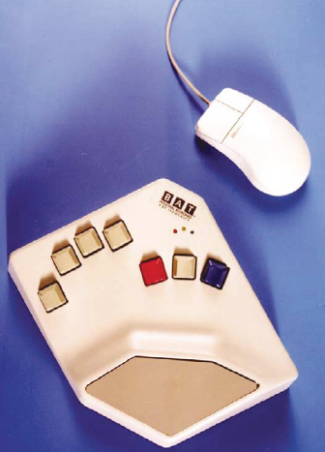
Chord Keyboard
An alternative to the QWERTY keyboard is the chord keyboard, on which several keys are pressed at once in order to enter a single character.
Chord keyboards can be very small. Where many chord keyboards can be operated with just one hand.
Training is required to learn the finger combinations needed to use a chord keyboard.
They can be useful where space is limited. Chord keyboards are also used for mail sorting.

Slide 8
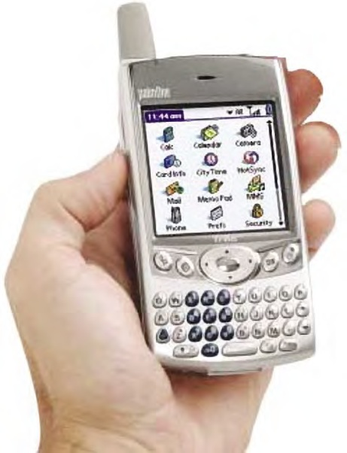
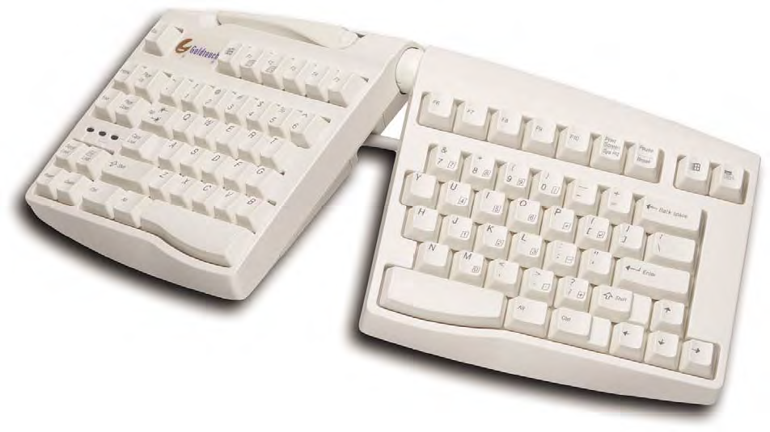
Alternative Shape of Keyboard
Choosing the Correct Keyboard, Keypad, and Buttons
What size do the keys need to be?
What shape should the keyboard be?
How robust does the keyboard need to be?
The size and robustness of the keys (buttons) also need to be considered if you decide to use a keypad or individual buttons.

Slide 9
Pointing Devices
Pointing devices are continuous input devices. This means they are particularly good at tasks that cannot be split easily into a number of discrete steps, such as dragging icons across the screen or drawing informal sketches.
The keyboard is a discrete input device and the mouse is a continuous input device.
There are two types of pointing devices: indirect and direct.
Indirect pointing devices require the user to move a screen cursor using a secondary device;
Direct pointing devices allow the user to point directly at the relevant position on the screen.

Slide 10
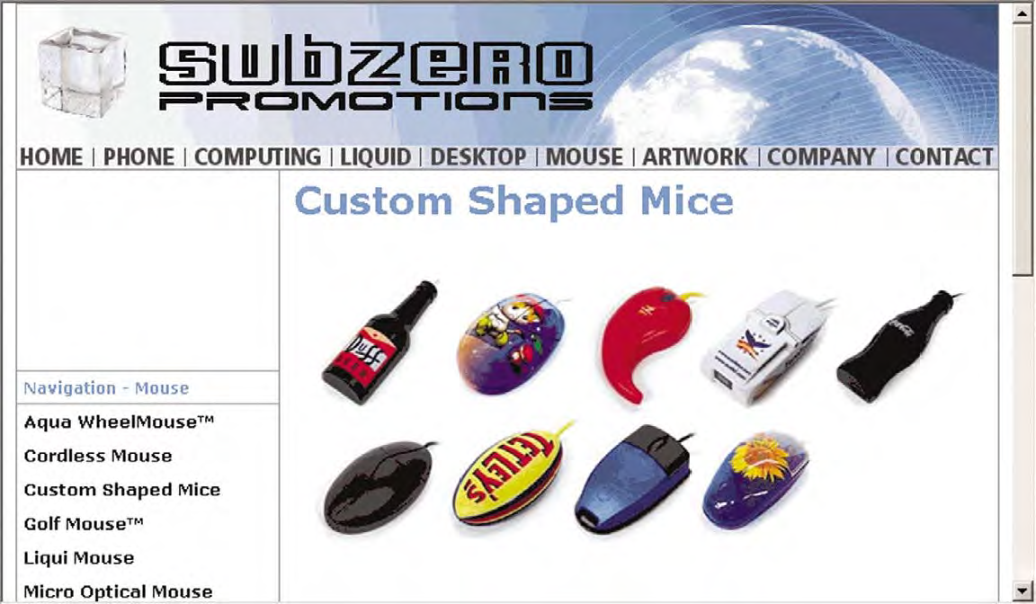
Computer mice in custom shapes

Slide 11
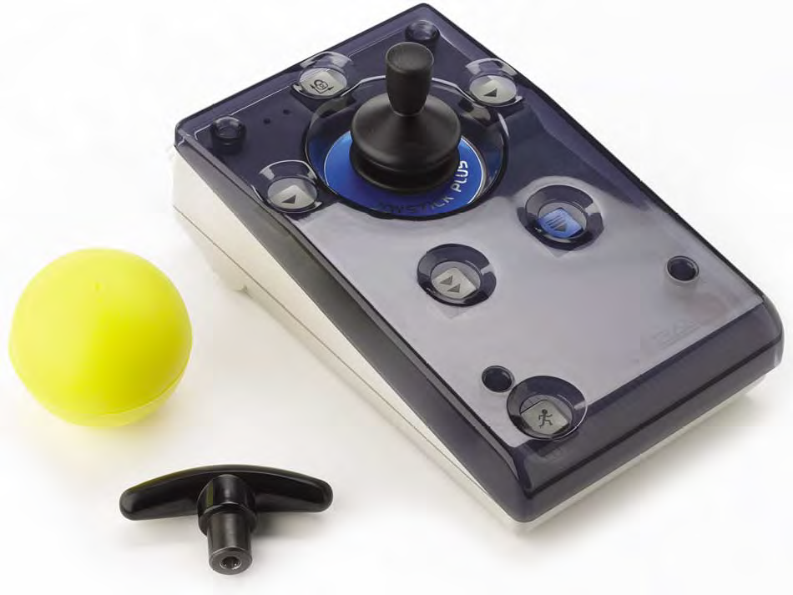
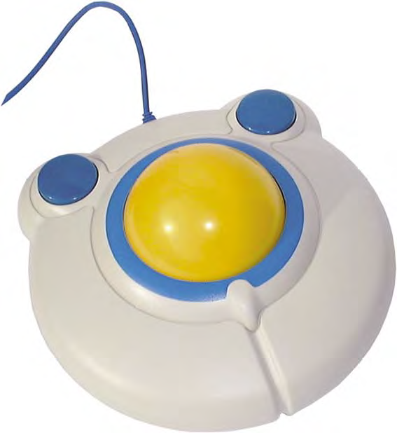
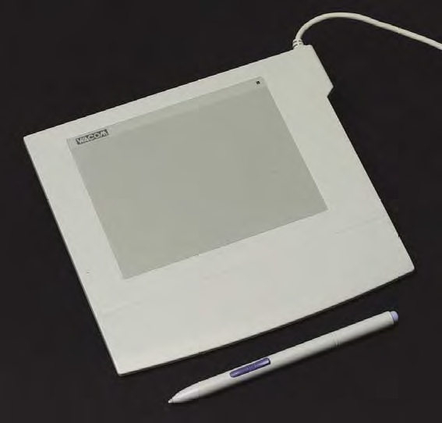
Other pointing devices
Other pointing devices are:
A joystickse.
A trackball
Graphics tablet (or tablet)

Slide 12
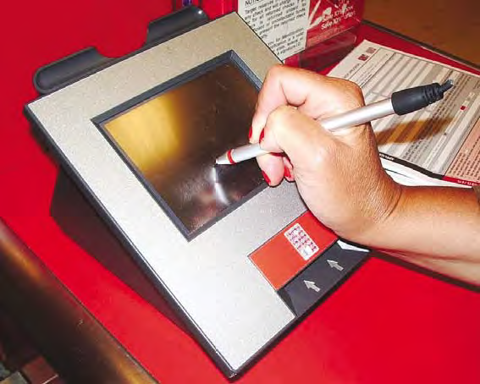
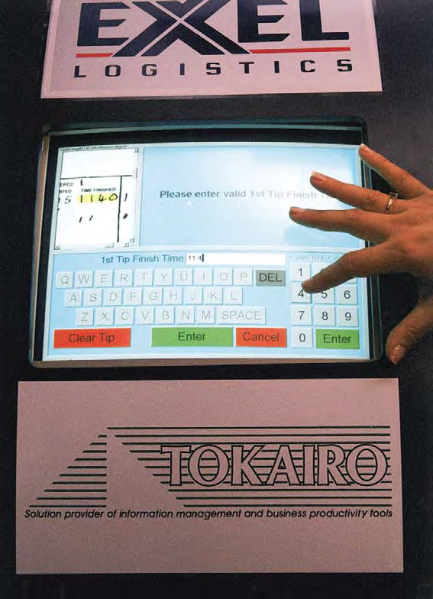
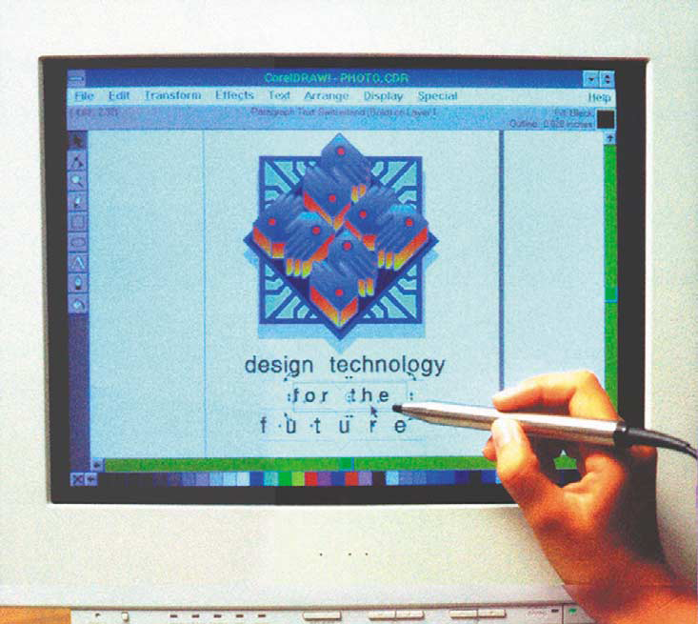
Different Types of Direct Pointing Device
Touchscreen
Pen system
Light pen is a stylus that contains a photo receptor. As the user points at a cathode ray tube screen, the light pen works out where it is being pointed by detecting the tiny variations in intensity of the light emitted by a CRT screen as the electron beam tracks horizontally and vertically across the screen.

Slide 13
Choosing appropriate pointing device
Consider the following questions:
How easy to learn does the device need to be? Direct pointing devices, like a stylus, tend to be intuitive to use, as touching and pointing come naturally in a way that using an indirect pointing device, like a mouse, does not.
How accurate does the device need to be? The pointing device should reflect the degree of accuracy needed to carry out the task. Touchscreens are generally inaccurate; Joysticks are also fairly inaccurate. When a device is inherently inaccurate, it is necessary to increase the size of the screen elements with which the user interacts.
How much time will the user spend on the system? the trackball is relatively comfortable to use, as the forearm can be rested on the table and the ball spun with the fingers.

Slide 14
Choosing appropriate pointing device
Consider the following questions:
How much space is there? The trackball, joystick, and touch tablet require very little room.
How robust does the device need to be? Touch screens are often used for public access systems, as they are easy to use and can be robust if sufficiently well built. Pen systems are not as good in these situations, as the stylus could be broken or stolen.
How manually dexterous is the user? Some users, such as children and people with disabilities such as hand tremor, may find it difficult to use devices that require a high degree of accuracy. Therefore, such users may find a touch screen easier to use than a mouse.

Slide 15
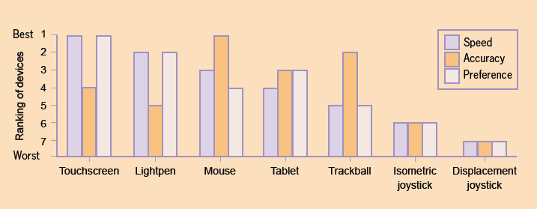
Comparison of pointing devices

Slide 16
Touchscreen, Trackball, Mouse
Touchscreen
It is easy to learn to use touchscreens.
There is a good search facility (i.e. Speed).
The total time spent on the system will be short,
Touchscreens are robust, which is necessary for a damp and dirty environment. Space is probably not an issue, but touchscreens are very compact.
However, they are not very accurate, so the screen buttons will need to be large.

Slide 17
Touchscreen, Trackball, Mouse
Trackball
Trackballs are robust and take up very little space.
Young people are familiar with trackballs on games machines.
They are more accurate than touchscreens.
Mouse
Many users will be familiar with the mouse as it so widely used.
It is more accurate than both the touchscreen and the trackball.
However, the mouse would not be suitable for outdoor use because it is not robust and could be stolen.

Slide 18
Output Devices
Four categories of output devices:
Screens are excellent for displaying complex visual data. They are the most common category of output devices.
Loudspeakers. These are needed for the more sophisticated inclusion of sound, such as music or speech.
Simple output devices. Most computer systems have a selection of lights, dials, and buzzers, often indicating the status of the system.
Refreshable Braille displays. These are used by blind people who are familiar with Braille. They display one line of Braille at a time, using small pins that pushup to create the dots of Braille.

Slide 19
Screens
Two main types of screen technology are commonly available: the cathode ray tube and the liquid crystal display.
The raster-scan cathode ray tube (CRT). This technology is similar to that used for the television and is traditionally applied to desktop computers. the device of choice for a cheap-and-cheerful computer system and for applications where very large screens with accurate color rendition are essential.
The liquid crystal display (LCD). LCDs are much smaller, thinner, and lighter than CRTs with the same visible area. They also consume less power. At first, they were mostly used in portable devices, but advantages in technology have made them affordable for ordinary desktop use.

Slide 20
Choosing the Right Screen
Several issues must be taken into account, such as the following:
How detailed does the image need to be? The resolution indicates the amount of detail that can be represented on the screen.
How many colors are needed? The number of colors available can vary from two (black and white) to millions.
How large does the screen need to be? By convention, screens have been measured across the diagonal, with common sizes for desktop monitors being 17 inches, 19 inches, and 21 inches.
Does the screen need to be portable? CRTs need an electrical supply and are very heavy. Thus, CRTs cannot be used for portable devices.
How much space is there? Increasingly, LCDs are used instead of CRTs for desktop PCs as they take up less space. This can be important in a crowded office environment.

Slide 21

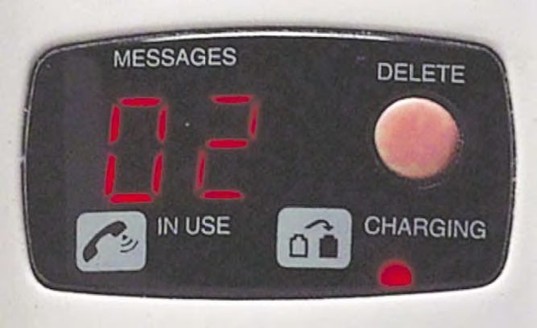
Simple Output Devices
There are a variety of simple output devices that can be used in the UI design in addition to (or instead of) a screen and loudspeakers. The most common of these devices are lights, dials, and buzzers. These devices are cheap, but they are extremely useful.
In addition, lights have a number of characteristics:
Color
Frequency of flashing
Brightness

Slide 22
THANKS

